Slide 1
CLLD in Sweden
Engaging, co-creating and fostering innovation

Slide 2
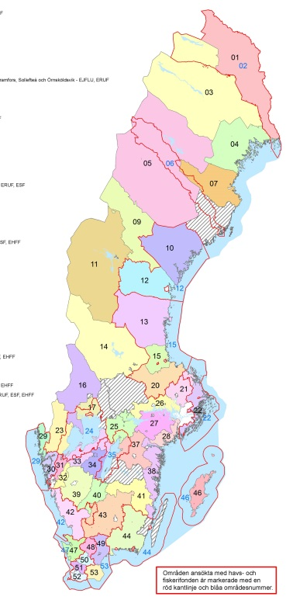
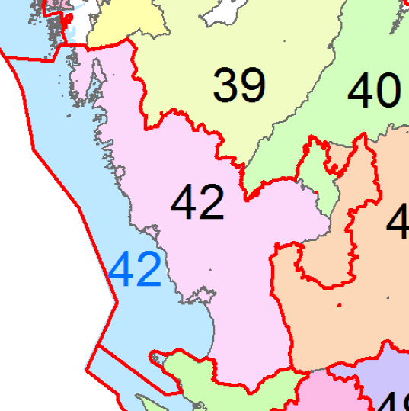
CLLD Halland

Slide 3
Model with intermediate body
EU
ERDF 6%
16,5 mio €
ESF 16,3 mio €
EMFF
16,6 mio €
EARDF
5%
200 mio €
Board of agriculture
CLLD-unit with 10-15 co-workers takes the task of MA
PA at different unit

Slide 4
CLLD Halland

Slide 5
Integrated strategy
Top down
Local strategy
Local needs /possibilities

Slide 6
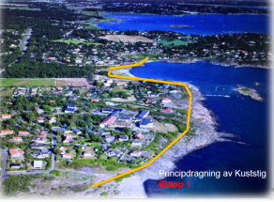
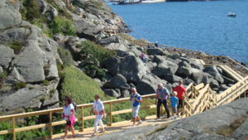
Åsa Coastwalk

Slide 7
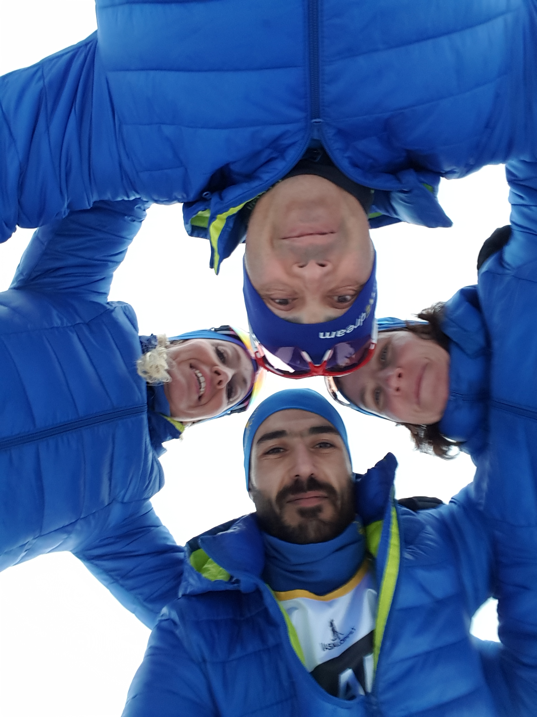
Team We Dream
”You have to belive!”

Slide 8
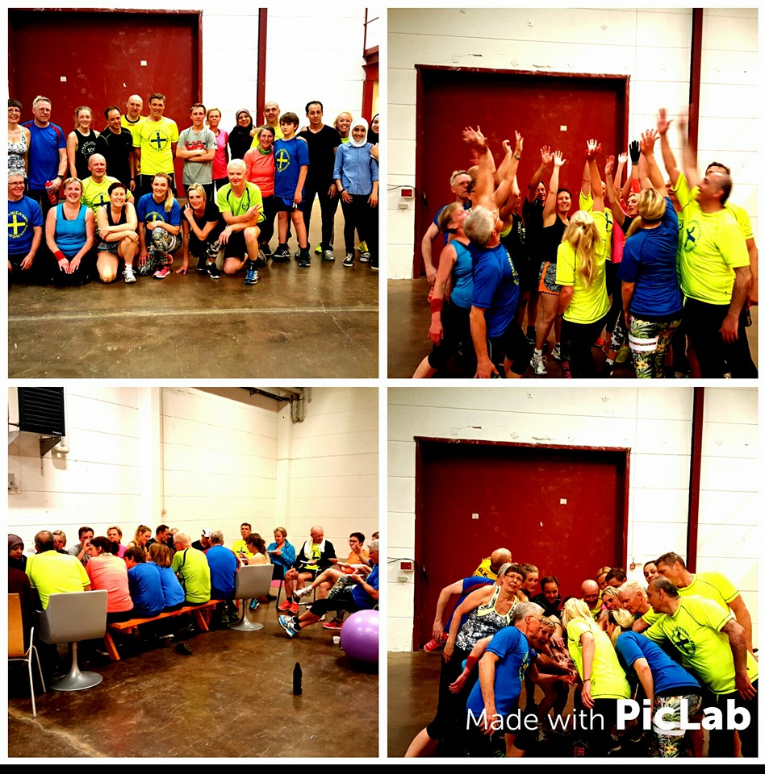
Team We Dream

Slide 9
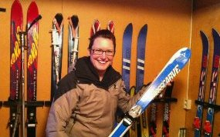
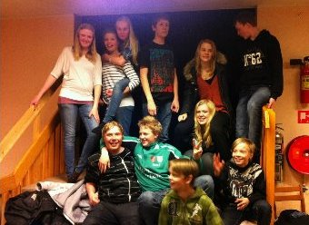
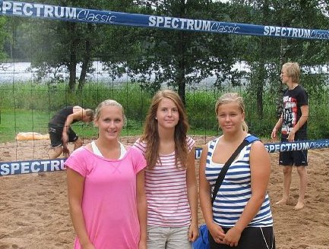
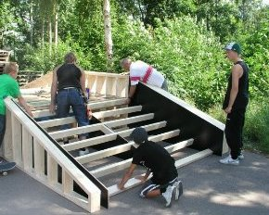
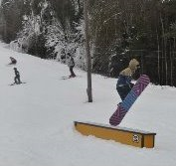
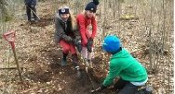
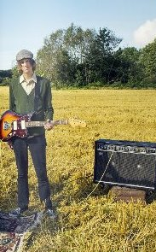
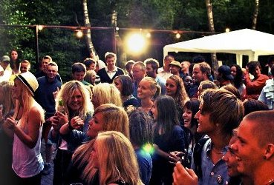
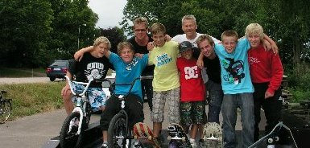
Youth in Halland

Slide 10
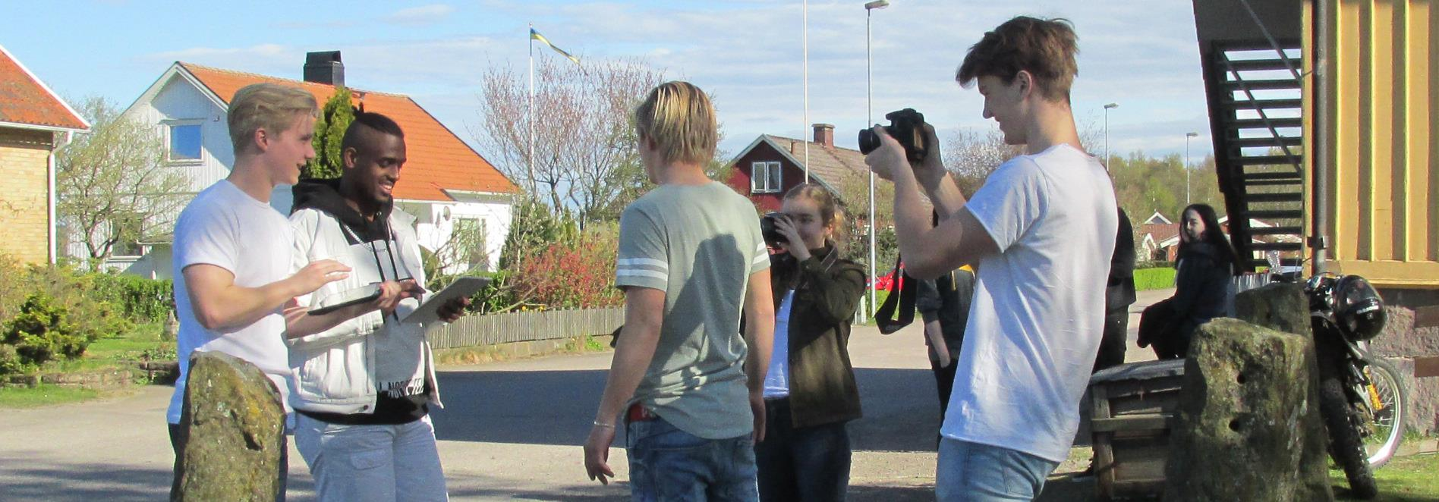
Ztella – young news

Slide 11
Westseaweek

Slide 12
State of play in Sweden
46 out of 48 areas have approved projectapplications (preparatory support included)
230 EAFRD
23 ERDF
17 EMFF
4 ESF
265 912 254 SEK - approximately: 28 112 981 €

Slide 13
State of play in Halland
 | Total | EARFD | ERFD | ESF | EMFF
Total support to project (SEK) | 49 825 632 | 30 930 774 | 7 161 699 | 3 956 224 | 7 776 935
LAG-decisions | 16 506 602 | 12 086 540 | 3 611 932 | 431 970 | 376 160
Remaining | 33 319 030 | 18 844 234 | 3 549 767 | 3 524 254 | 7 400 775
Number of projects | 28 | 16 | 5 | 2 | 5
18 approved at MA

Slide 14
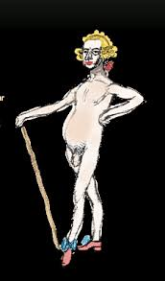
CLLD – does it work?

Slide 15
CLLD – does it work?

Slide 16
Some results from Leader Halland
103 new businesses
197 new jobs
12 233 active volunteers
272 958 visitors or spectators
111 new meetingplaces
59 new products
261 ongoing activities
And much more….!

Slide 17
Conclusions
Intermediate body
The method through storytelling and statistics
Thankyou!

