Slide 1
Other voices?
John Grieve
ENRD Contact Point
ELARD Gathering
Brussels
31 May 2017
Notes:
Challenges, difficulties, frustrations, bureaucracy, admin and SIMPLIFICATION
But still here and trying to do it better – at the heart of now and the future
Cork Action plan : Actions on 10 points – all link to LEADER
resilience, generational
renewal, rural value chains, digitisation,
smart villages, social inclusion, climate
change, circular economy, broader
innovation……
Processes – Rural proofing, bottom-up LEADER, simplification, communication……

Slide 2
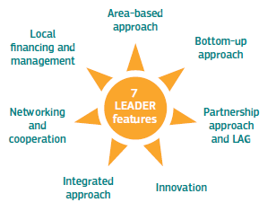
In the beginning LEADER was the innovation!
(and simplification!!)
Notes:
Link to Cork 1
From the method in LEADER 1 to CLLD
Method, laboratory, strategy and all rural areas, mainstreaming, multi-funding
STILL HERE
An integral part of the process, an objective, a sustainable outcome and a tool
Links are also integral to LEADER and these need to be strengthened in whole approach, innovation a case in point
Change mgt theory, link to LEADER and to innovation
STILL THE FOCUS
Was also supposed to be a simplification
But mainstreamed and multiplied

Slide 3
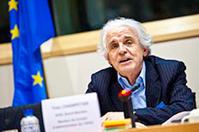
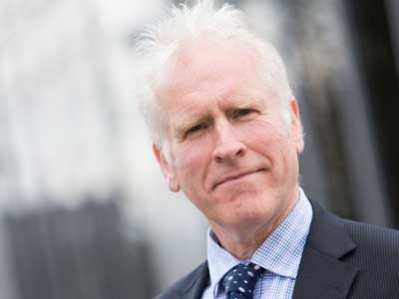
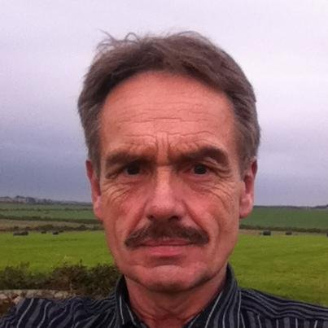
Båstad Inspirations
‘a disruptive innovation, area based, locally managed, around a network’
A laboratory of innovation and transition, ‘think tanks’ of their territories
Mainstreaming and expansion - constant need to simplify
A method to create hope and invent a more inclusive, sustainable and smart future
(Yves Champetier)
CLLD can be agile, needs driven, relevant, permit risk taking, and learning
Too complex, inflexible, not attractive
Rural urban barriers not needed
(Peter Cook)
Use small things to make big things happen – progressively linking actions and resources from a LEADER base
When CLLD is present conflicting agendas are forced to work together
Exploiting our natural resources for sustainable economic benefit
What makes us different makes us interesting, what makes us interesting makes us marketable, what makes us marketable drives us up the economic ladder
(Gerralt Llewelyn Jones)
Notes:
What makes CLLD different is bottom up, place based approach with grass roots policy implementation.
Decision making more relevant and connected to local people.
EU more relevant and connected to local people.
Stakeholders need to make the strong evidence based case for the future demonstrating the added value.
Omnibus Regulation should help CLLD work better.
Avoid gold plating, focus on results.
Promote and permit innovation, take some risks and learn.
Keep communicating and networking, working on the method at all levels, build capacity, take necessary small steps.

Slide 4
The Båstad ‘Improvement Agenda’
Local partnerships and governance
‘Moving CLLD from hierarchy to cooperation’.
‘Producing a CLLD communication plan’
‘Reinforcing bottom up by putting trust in local governance’
Financing, delivering, reporting
‘Allowing innovation by allowing failure’
‘Real decision making by local people’
‘Active and integrated communication plan’
Working with local assets
One simple implementation rule and body for CLLD
‘Better delivery system with exchanges and a working group’
‘Harmonising CLLD delivery systems’
Notes:
‘Moving CLLD from hierarchy to cooperation’ - improve results by increasing ownership, common understanding and motivation. All stakeholders responsible.
‘Producing a CLLD communication plan’ to strengthen understanding at all levels and demonstrate added value. LAGs, MAs develop or refresh Communication Plans, supported by NRNs, ENRD.
‘Reinforcing bottom up by putting trust in local governance’ identify simple steps to increase trust, e.g. regular meetings between MAs and (F)LAGs with a neutral chair.
‘Allowing innovation by allowing failure’ - release potential, innovate and learn. Simplify regulations, change rules, adapt success criteria. Train delivery chain, change attitudes, build trust.
‘Real decision making by local people’– respond to need, build bottom up trust, include riskier projects. Include, engage communities funds serve, shift power towards local, pursue co-responsibility and common interests.
‘Active and integrated communication plan’ - share clear, simple, audience appropriate messages, empower benefitting communities. Transparent process, learn from each other, build trust and stronger relationships
One simple implementation rule and body for CLLD –improve LAG’s autonomy and responsibility, ‘one basket of money for CLLD’. More inter DG structures to facilitate simpler rules, for Member States a single CLLD delivery body.
‘Better delivery system with exchanges and a working group’ – more beneficiary orientated delivery. Working group to identify critical issues, exchange good practice, strong will to effect change.
‘Harmonising CLLD delivery systems’ – creating speedy, flexible processes incorporating local needs into national systems. Flexible interpretation of regulations by MA. Trust and good communication essential.

Slide 5
Practitioner Working Groups
Working in the delivery chain, user focused, facilitating tools
Cooperation, common templates, definitions, criteria and tools
Innovation low in practice but high demand
Innovating in the LAG, innovating by the LAG, innovating through the LAG
Exchange experience, common understanding and approaches
‘New’ enabling roles, innovation brokers, TNC coordinators etc
Prioritisation of Compliance – Bureaucratic burden - Ease the pressure, implement the method
Working smarter
Notes:
Improvement oriented – revitalise - renew
Focusing on two elements of the method

Slide 6
Other Ideas
Much loved classic - fit for today? 25 years on and still giving grants?
A shift from ex post controls on compliance to results-based funding – but how in practice?
Sustainable change is human change – but when to measure?
LEADER animates – beneficiaries innovate - Invest in the method, e.g. budget based on animation activity?
Demand aggregation, clustering, crowd funding, mentoring, organisation, brokerage etc – Links - LEADER concepts at heart!!
LEADER as a platform - citizen led investment in strategic local assets and enabling conditions using multiple forms and funding sources.
Governance + Greater Proportionality Outreach, engagement, mobilisation and empowerment
Notes:
Cork
LSG
OECD
PWGs
LAGs
Stakeholders / networks
Events Business seminar, LINC x 2 etc

